Slide 1


Mantid Scientific Steering Committee
Nick Draper
10/11/2010

Slide 2




Major Tasks presented last meeting
General
  Easy user control for plotting distribution data
  Script Library integration
  Multi file loading and summing
  Engineering support
  Improve Instrument view performance
Technical
  VS2010
  Build System improvements
  Code and quality review
  Windows 7?

Slide 3


Major Tasks presented last meeting
SNS
  Filter / split event data (script only)
  SNS meta data (ICAT) search
  Event Workspace improvements
  Initial indirect inelastic integration
  Further Powder diffraction integration
  Further direct inelastic interface integration
  Preliminary event nexus support
HFIR
  SANS GUI
  Triple Axis support

Slide 4
Major Tasks presented last meeting
ISIS
  Continued work on Monte Carlo absorption correction
  Matlab interface
  Tosca (Vision) support
  Vesuvio support
Visualisation and Analysis
  Limited Prototype
    Multidimensional workspaces
    4 Dimensional parallel visualization of large datasets
    Initial cutting and slicing operations
    Simple background quantification

Slide 5
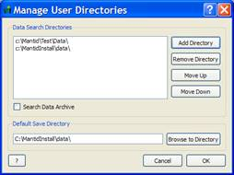
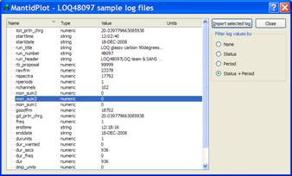
Progress over the last iteration
User interface changes
  Easier to use Custom Interfaces out of the box
  Simpler control of data paths
  Improved display of sample log values
  Improvements to the script interpreter window
    Intelligent cursor positioning
    Copy & paste support

Slide 6
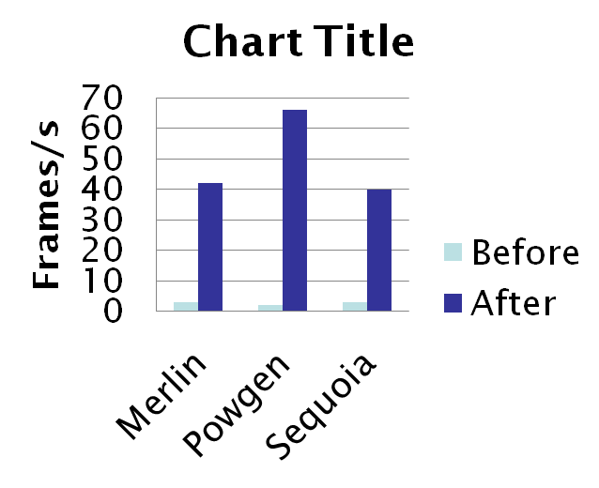
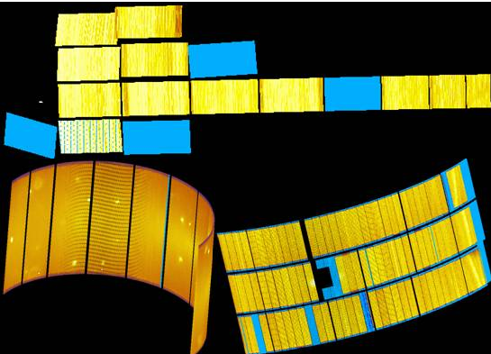
Progress over the last iteration
Instrument Display
  Plotting each tube or rectangular detector as a single object
  Texture mapping
  ↑ ↑ performance

Slide 7
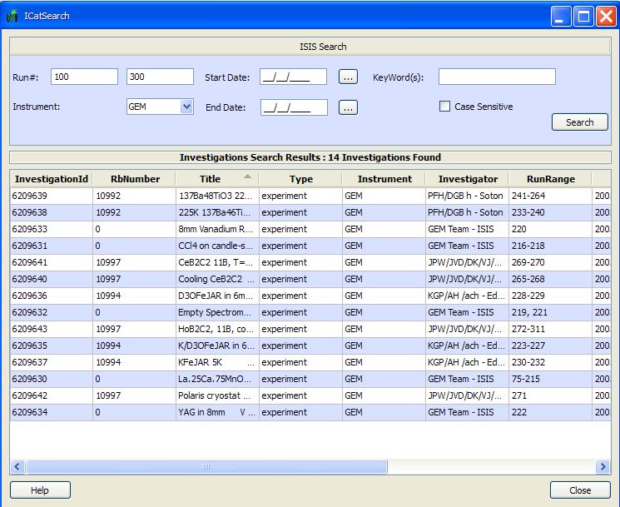
Progress over the last iteration
Framework
  Catalog Search
    Previously ICAT searching
    Support different back end catalog
    Allows Multiple catalog searching
    ICAT3 implemented so far
  Initial Monte Carlo engine added
    Building block for absorption corrections

Slide 8
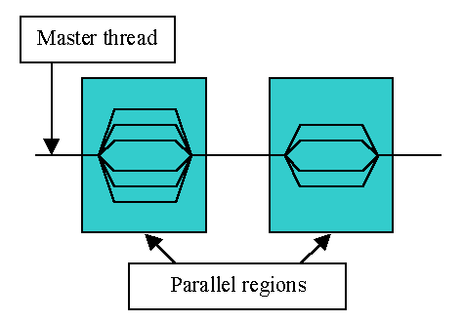
Progress over the last iteration
Performance
  Improved Instrument display performance
  SumSpectra Performance ↑ 100×
  Long logs now read in seconds rather than minutes
    Particularly SNS proton charge logs
  Several memory leaks resolved

Slide 9
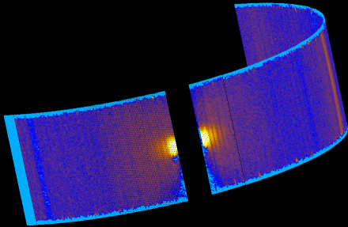
Progress over the last iteration
Event data
  EventNexus file support
  Generic support for Nexus Monitors with LoadNexusMonitors
  Event Filtering:
    FilterByTime
    FilterByLogValue
  Event list combination
    Plus or MergeRuns
    ConjoinWorkspaces to combine two separate SNAP event files
ORNL instrument support
  Powder diffraction support via script
    Including alignment for Powgen

Slide 10
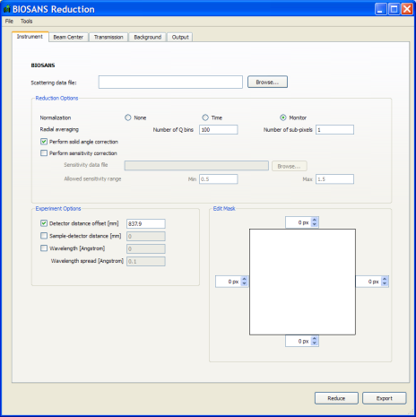
Progress over the last iteration
HFIR SANS
  New interface for HFIR SANS reduction
  Export the reduction parameters as a Mantid python script
  Save your work and re-use your reduction process with multiple data files
SANS
  The SANS interface now allows the flood file correction file to be viewed/specified

Slide 11
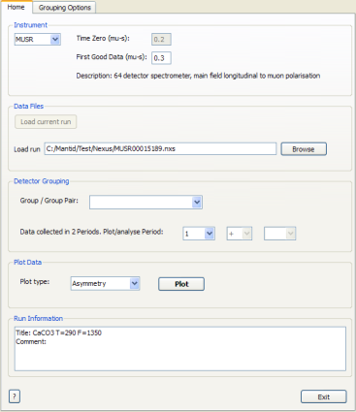
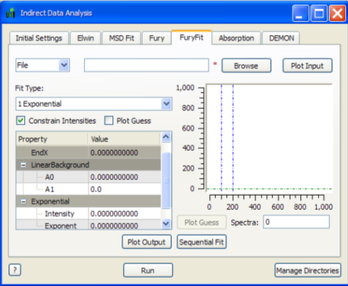
Progress over the last iteration
Muon
  Now supports multi period data
  Load current run from DAE
  Estimates Alpha value
Indirect Inelastic
  Convert to Energy
    New SofQW tab giving user control of the S(Q,w) conversion
    New diagnostics tab providing slicing functionality from Modes.
  IndirectAnalysis interface
    Fourier transform fitting
    Elastic Window performance improved

Slide 12
Progress over the last iteration
Powder Diffraction
  Absorption Corrections for large samples now support gauge volumes
  Improvments to the robustness of GetDetectorOffsets
  DiffractionFocussing for EventsWorkspaces now rebins the data to the valid d-spacing range
Instrument Definitions
  Updates: SNAP, Powgen
  Performance improvements: MERLIN, MAPS, WISH, ARCS, SEQUOIA, POWGEN
Crashes/Bugs
  10 Notable bugs corrected

Slide 13
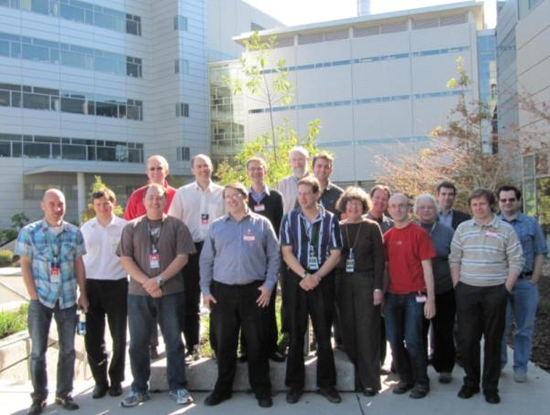
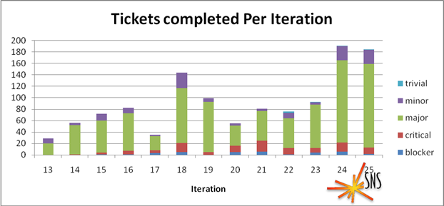
Mantid Workshop
2 Day workshop
  US and some UK staff
  Many of the staff had never met
  Very full agenda
Benefits of collaboration

Slide 14
Next Release
Target Date
  20th December 2010
Major Items
  General
    Easy user control for plotting distribution data
    Multi file loading and summing
    Python interface improvements
  Technical
    Build System improvements
    Python code and quality review

Slide 15
Next Release
  SNS
    File Archive search support
    SNS catalog search
    Event Workspace with weights
    Further filtering & splitting event data
    Initial indirect inelastic integration
    Powder diffraction user interface requirements
    Direct inelastic user interface integration
    EQ-SANS requirements
  HFIR
    SANS GUI improvements
    Initial Triple Axis support

Slide 16
Next Release
  ISIS
    Continued work on Monte Carlo absorption correction
    SANS 1D & 2D data investigation and improvements
    Further Indirect Interface improvements
    Further Muon interface improvements
    Vesuvio support
  Visualisation and Analysis
    Limited Prototype
      Multidimensional workspaces
      4 Dimensional parallel visualization of large datasets
      Initial cutting and slicing operations
      Simple background quantification

